Slide 1
Virtual National Members’ Meeting for England Wednesday 14 July 2021 at 18:30

Slide 2
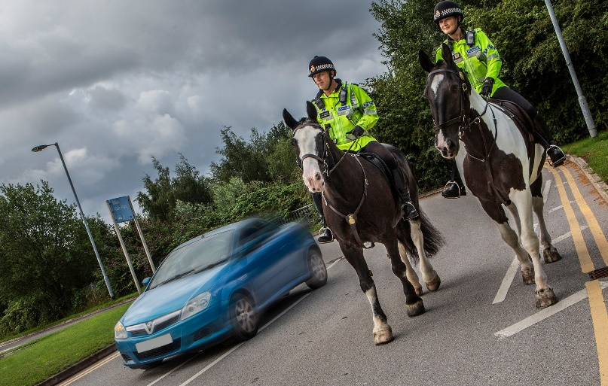
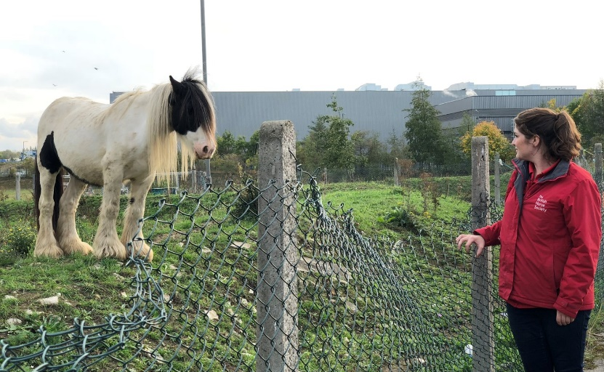
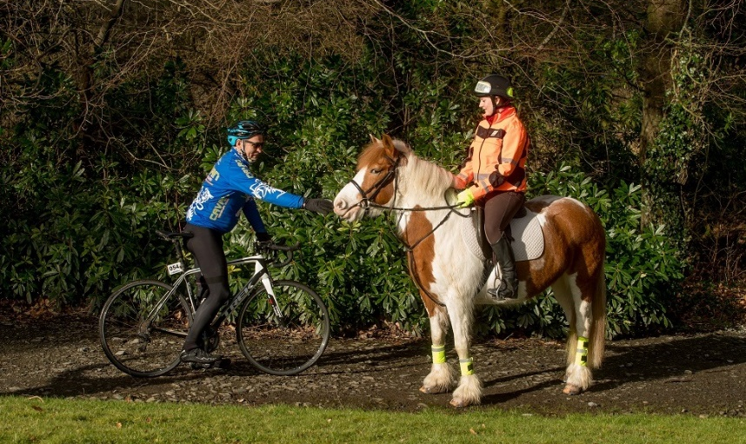
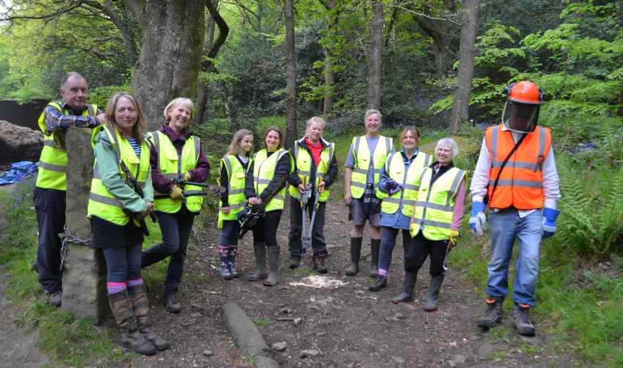
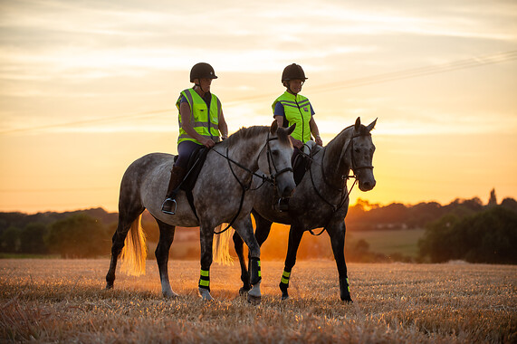
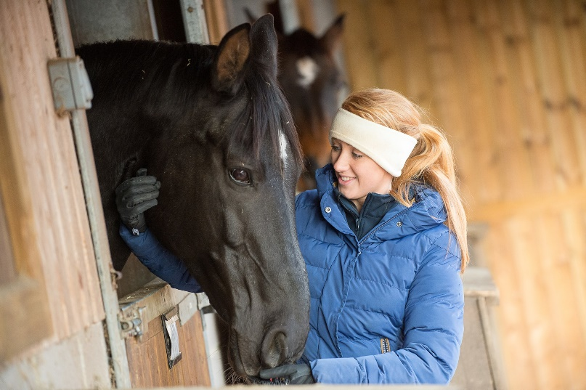
Welcome
2

Slide 3
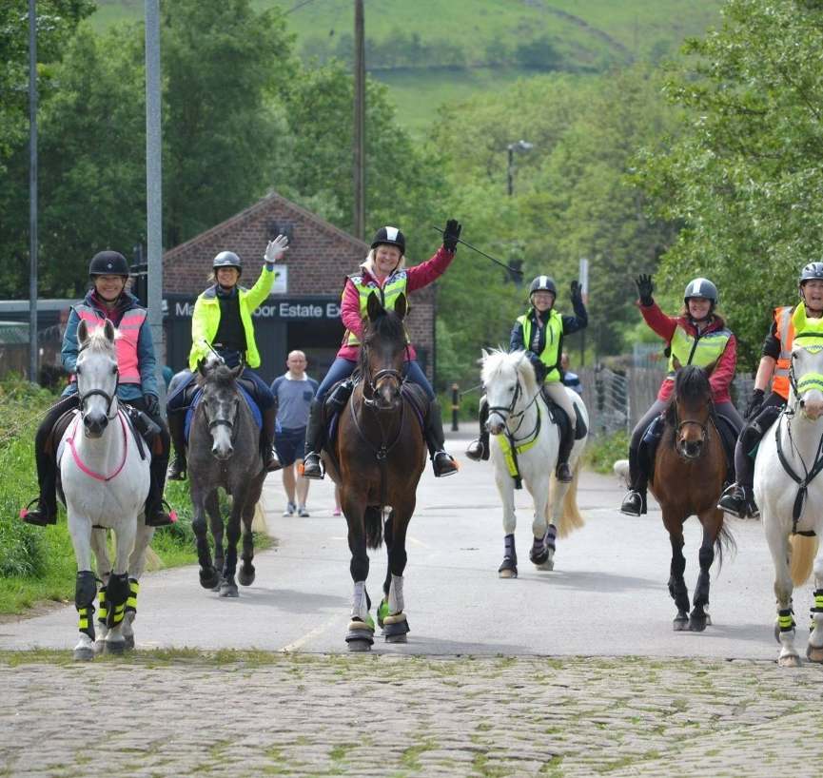
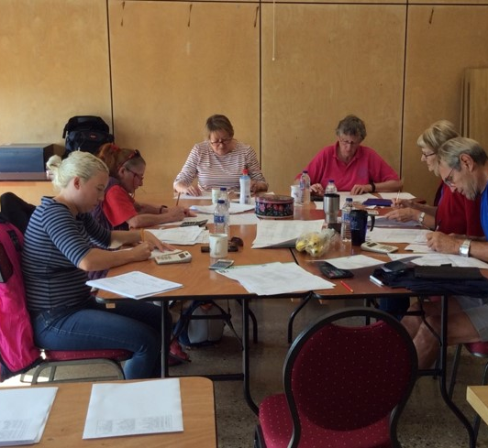
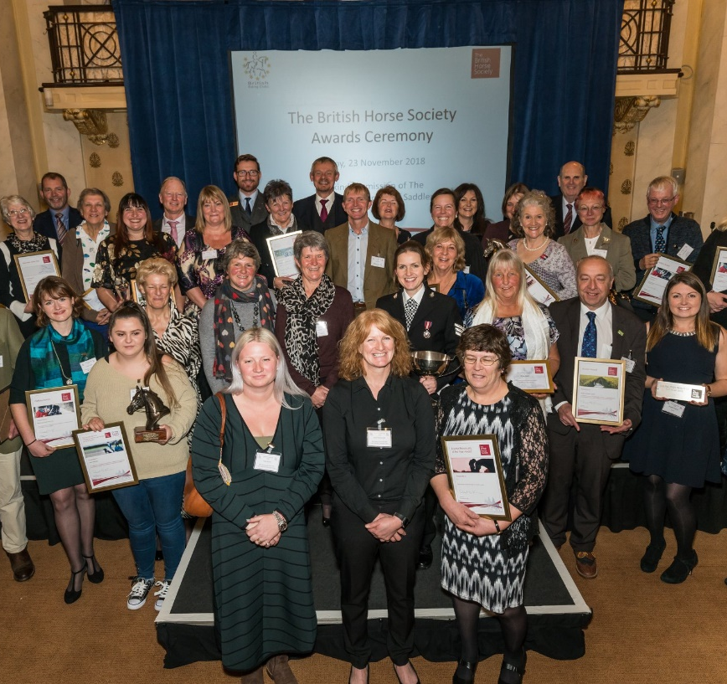
Volunteers
Specialist Trustee for Volunteers
1050 Volunteers helping the BHS with campaigns, events and fundraising!
Everyone can help us from our occasional volunteers to our specialist roles in Welfare, Access & Safety
Across the UK our volunteers have huge impact in their local communities
The last 12 months ...
3

Slide 4
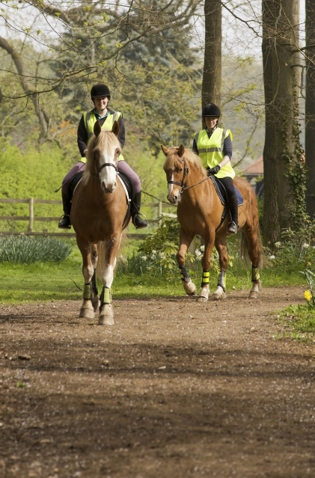
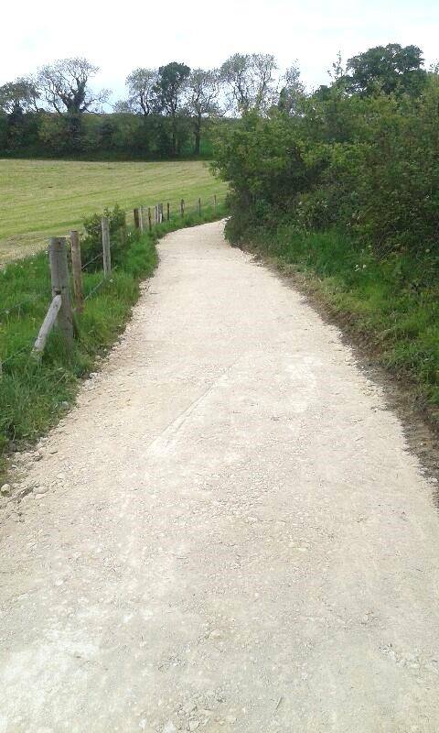
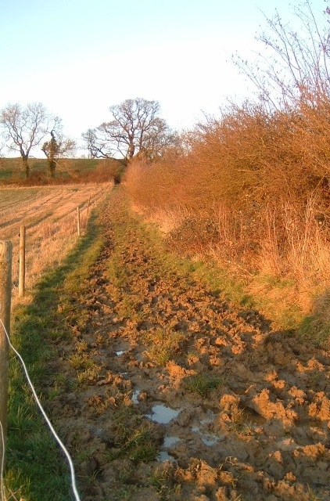
Access
Access Field Officers
Project 2026
Ride Out UK/Ride Out Fund
Lobbying
Access Volunteers
4

Slide 5
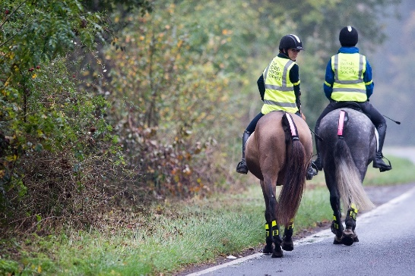
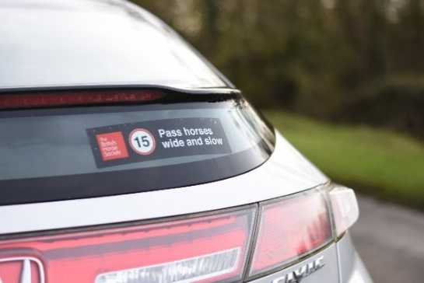
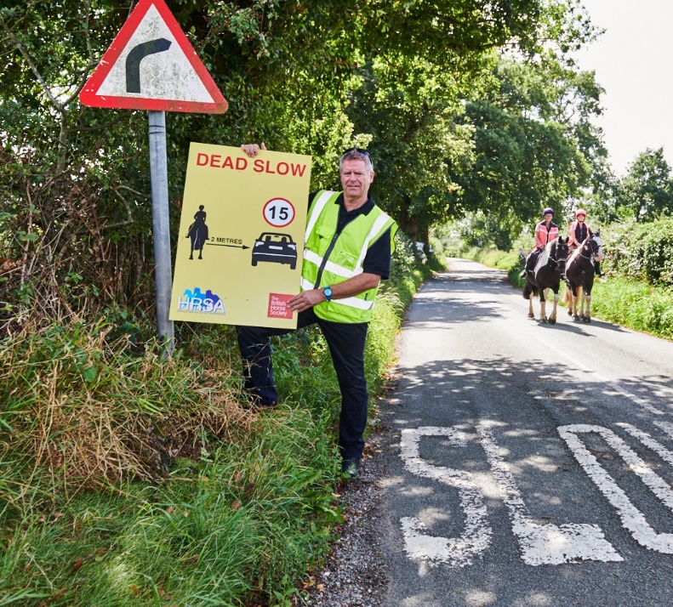
Safety
Horse i App – you never know when you’ll need to report an incident, so why not download the app now?
Highway Code Review
Horse Incidents – DfT project
Dead Slow Signs
PR Dare Awards
5

Slide 6
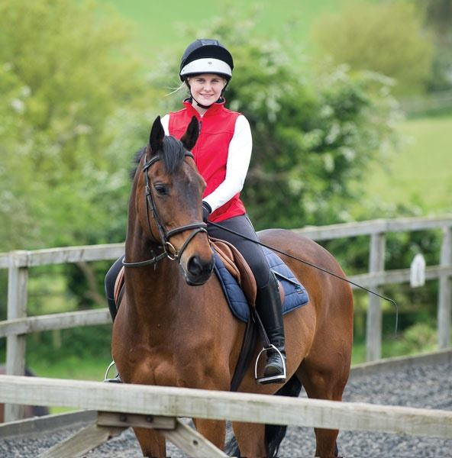
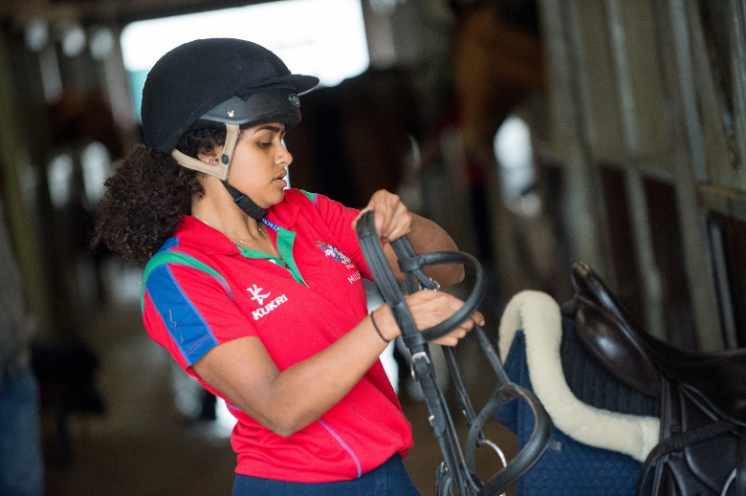
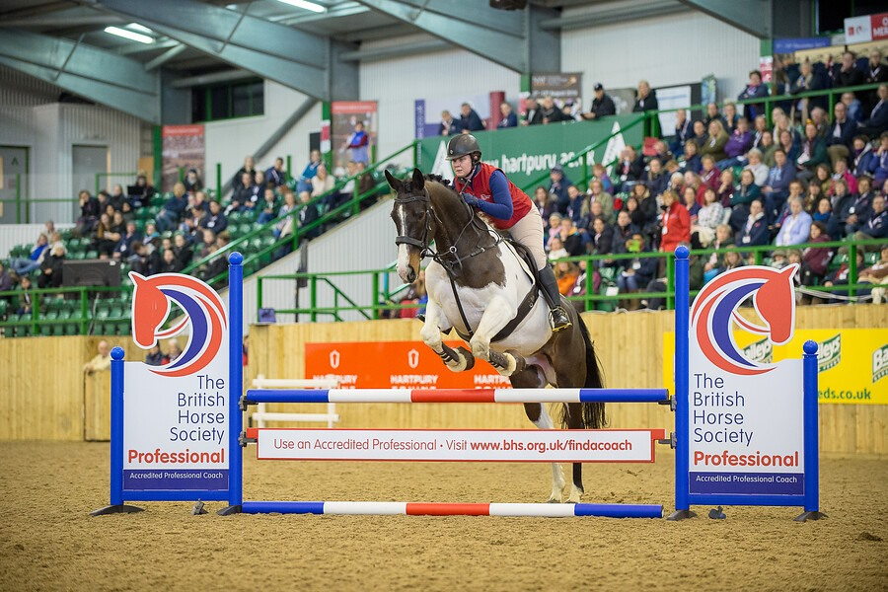
Education
Covid Changes and Delivery
Launch of Pony Stars
Piloting of four new courses
Development of new teen programme
6
6

Slide 7
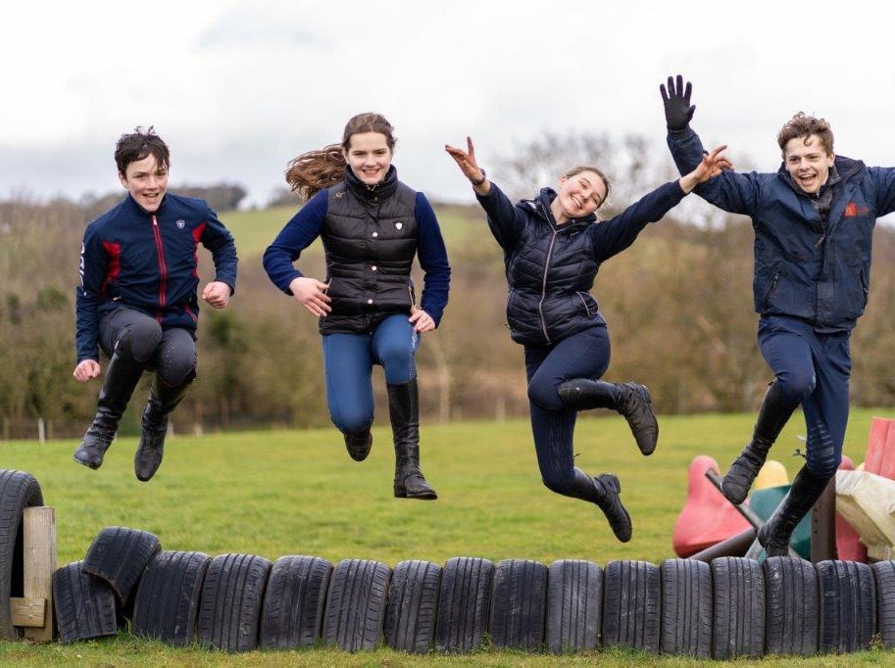
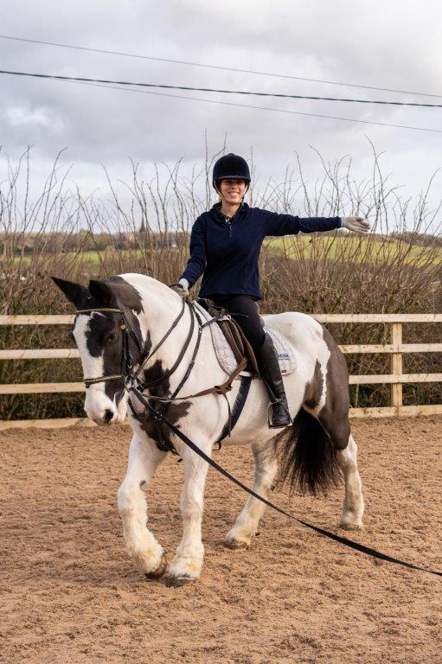
Participation
British Riding Clubs – the biggest online competition in the world?
Over £1,000,000 of support for our BHS Approved Centres
Second Chance – rehoming horses and ponies into our riding schools
Sky partnership – reaching 7 million potential customers
Changing Lives Through Horses – new programme for ages 5 to 25
7

Slide 8
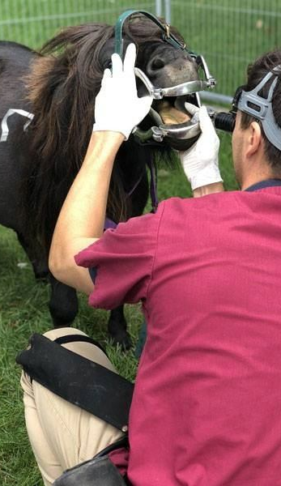
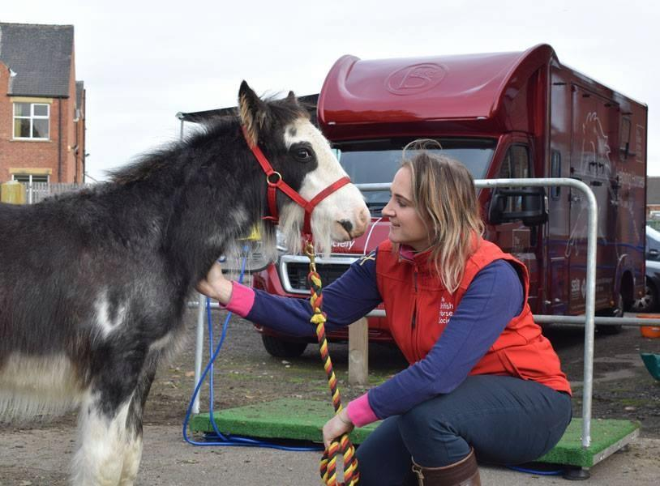
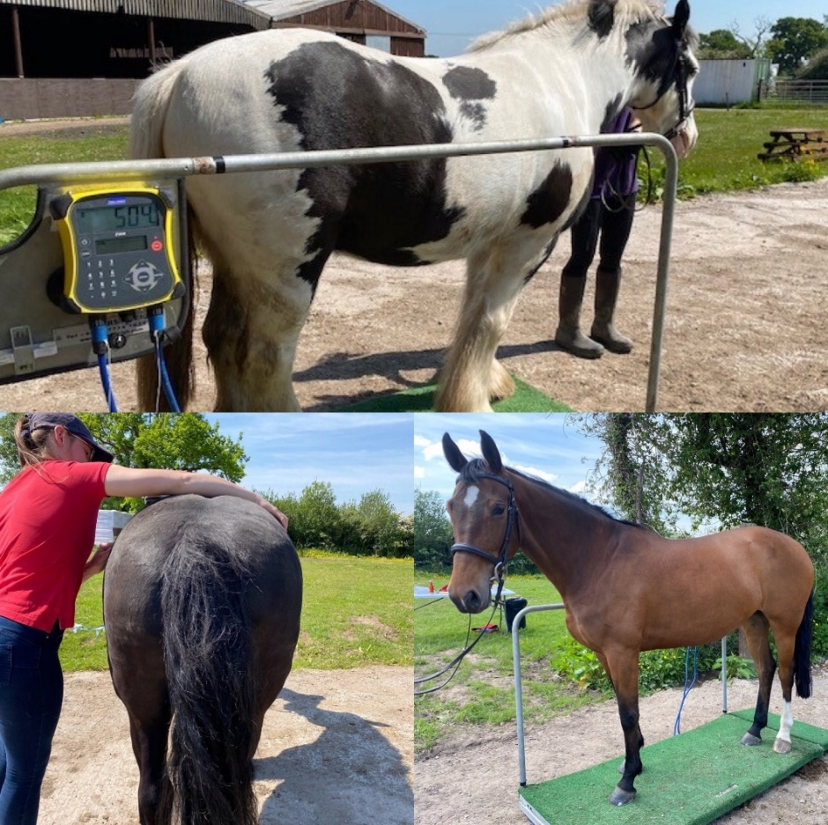
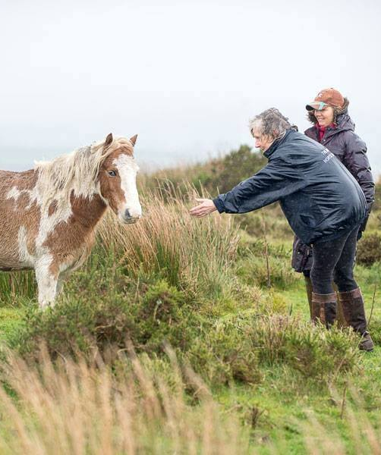
Welfare
Proactive Welfare Education
Healthcare & Education Clinics
Over the last 12 months our Helpline was contacted 16,563 times.
Chip ‘n’ Go!
Welfare Education Campaigns
8

Slide 9
Members’ Question & Answer Session
9

Slide 10
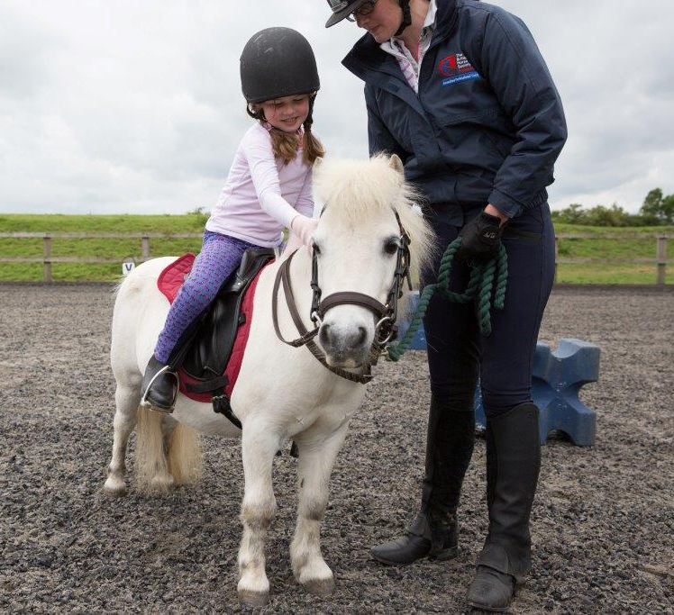
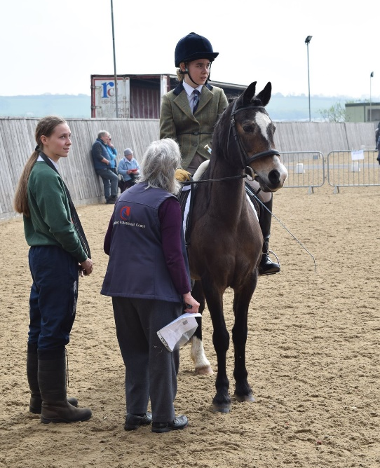
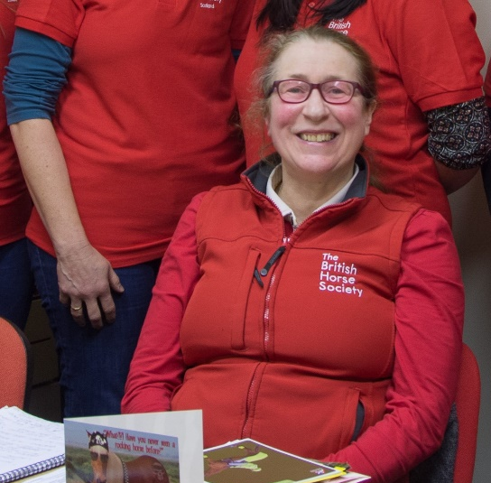
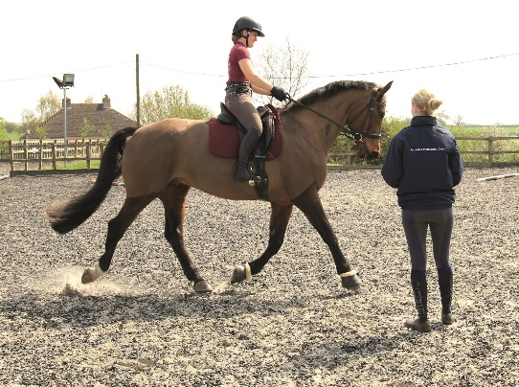
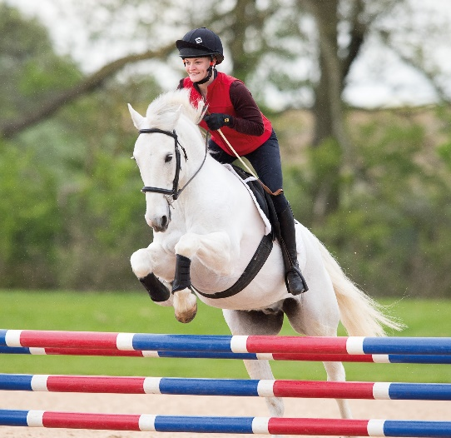
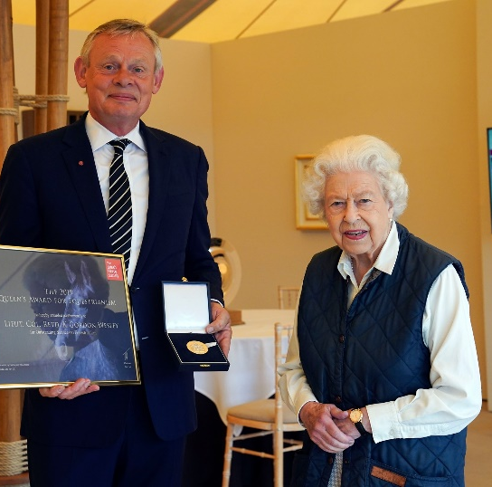
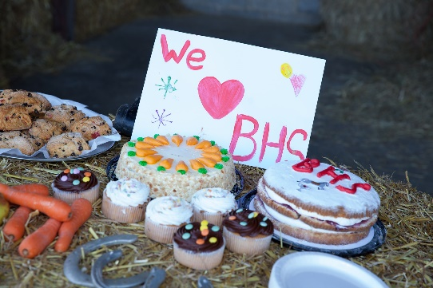
Thank you & close Tim Lord – Chairman
10

